Slide 1








Journey To Your Best
Challenge
0
Khuat Bao Nguyen

Slide 2




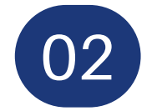


Top-down approach
01
03
05
Definition
Pros and Cons
Keywords
02
04
Steps
When to use

Slide 3

What is top-down approach?
1
Broad-to-detailed methodology
2
Understand the big picture
3
Focus on crucial components

Slide 4





Steps of top-down approach
Define the problem
Clearly understand what the main goal is
Define the principles/requirements
Further decomposition
Break down major components into smaller subcomponents
Deal with the crucial components first
Identify main components
Break down the goal into major components
Can use 5W1H method
Repeat for subcomponents
Prioritize components
Determine the order of priority for each components
80/20 principle

Slide 5
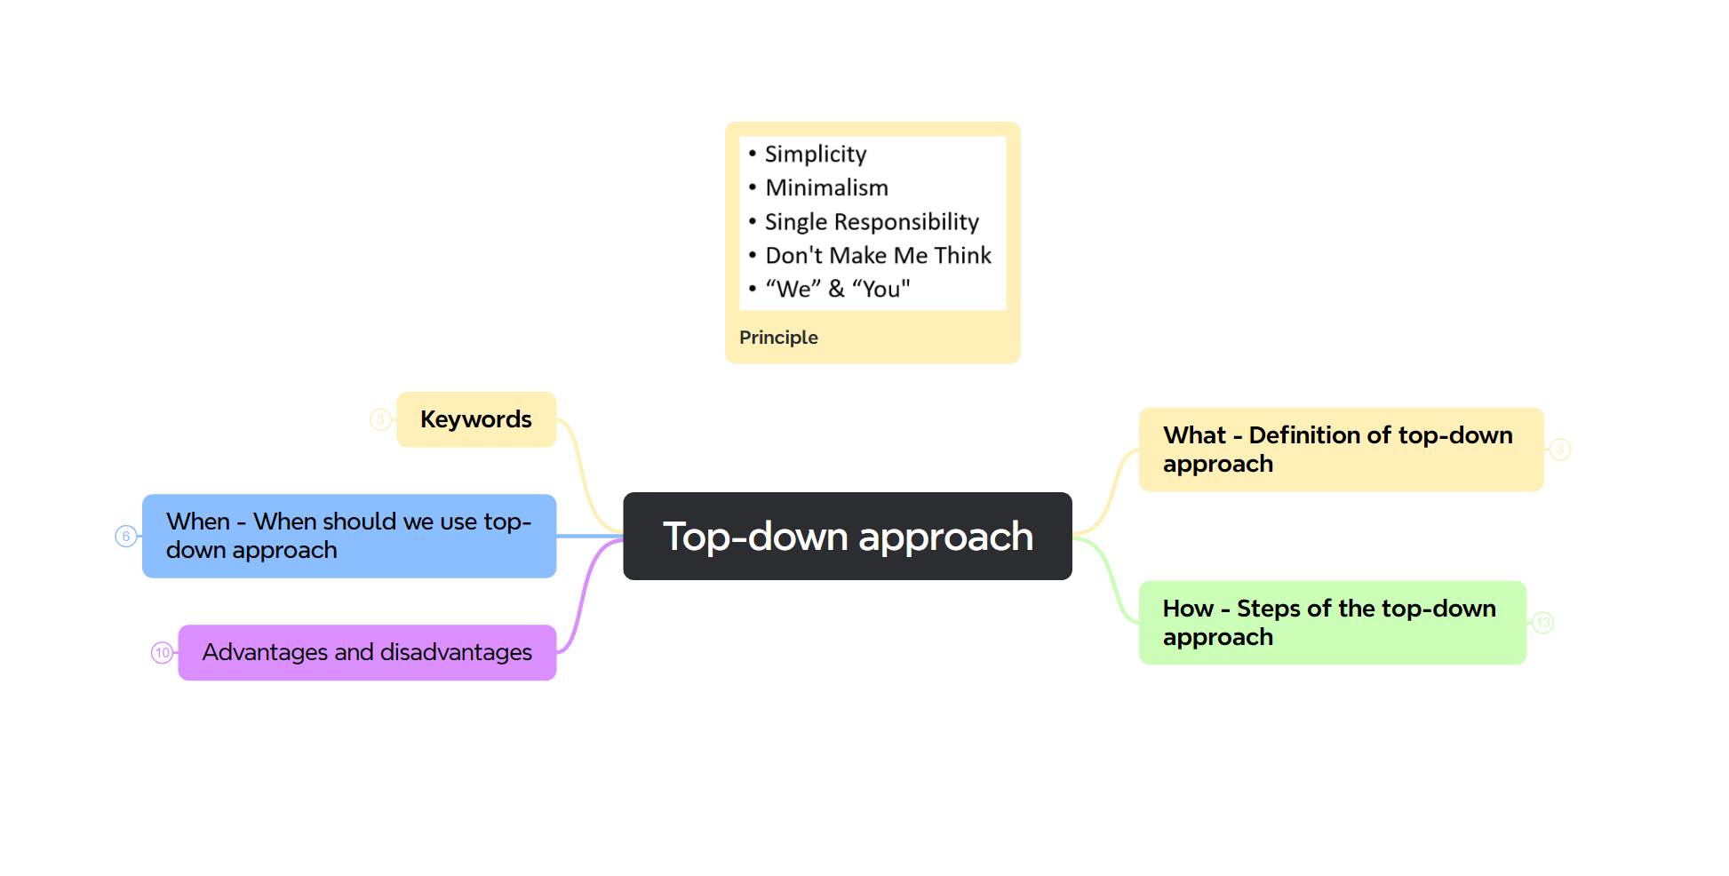
Example of applying top-down approach

Slide 6

Pros and Cons
Pros
Cons
Clear understanding
Effective resource allocation
Maintain sights of primary goals
Risk mitigation
Communication challenges
Overlooking details
Dependency in initial planning
Potential lack of creativity

Slide 7

When should we use top-down approach?
Complex problems
Project planning
Reading
Team Collaboration
Predefined goals
Software development

Slide 8




Keywords
BIG PICTURE
DECOMPOSITION
RESOURCE ALLOCATION

Slide 9
Learn and learn fast
01
03
05
How to learn and learn fast
Why your ability to learn fast matters
Keywords
02
04
Resources for learning
When to learn

Slide 10
How to learn and learn fast?
Set clear goals
Know the why (why you want to learn)
Define specific, achievable goals
Practice regularly
Do exercises and personal projects
Apply for an internship to get hands-on experience
Prioritize
Identify the most critical concepts related to your goals
Focus on mastering the the essentials first
Get feedback
After learning, get feedback from the others to see if you have reached your goals
Make use of multiple resources

Slide 11

Resources for learning
Human resources
Technology
Traditional resources
Social media
Learning methods
Others

Slide 12


Why your ability to learn fast matters?
For you
For your team
Adaptability to change
Increased productivity
Personal confidence
Career advancement
Enhance team productivity
Increased team confidence
Improved communication
Positive team dynamics

Slide 13
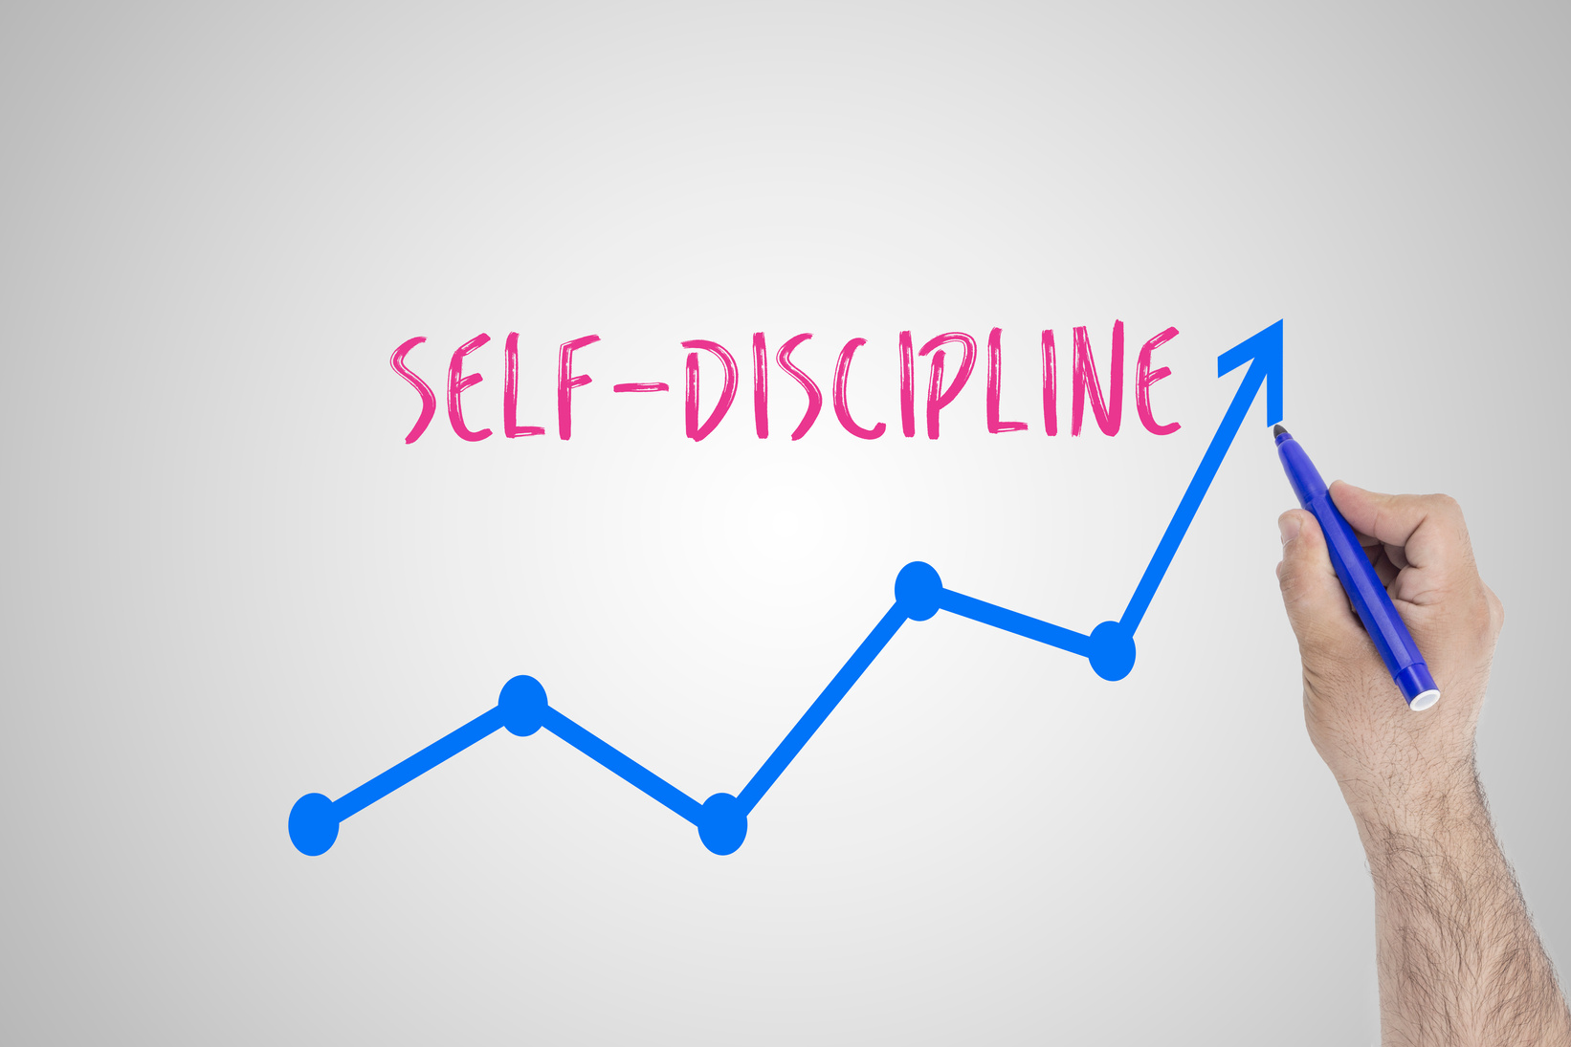
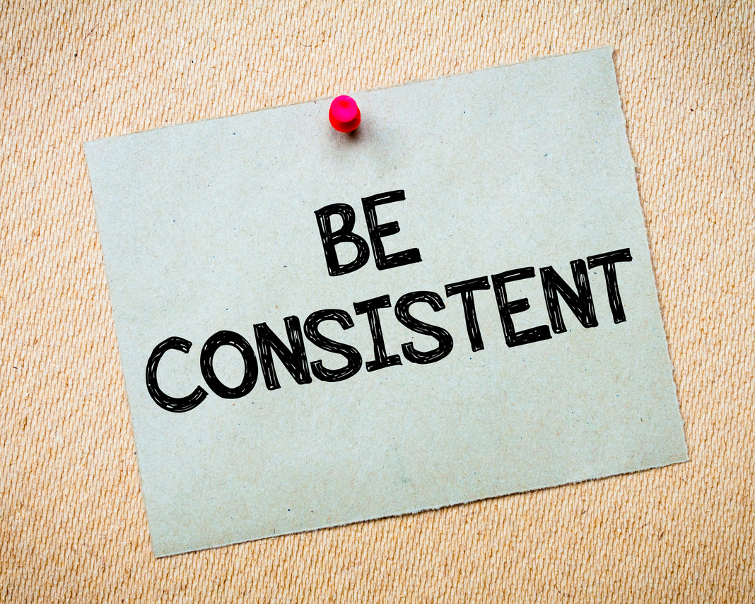
WHEN
TO LEARN
ANYTIME

Slide 14



Keywords
MAKE USE OF EVERY AVAILABLE RESOURCE
DISCIPLINE AND CONSISTENCY
CLEAR GOALS

Slide 15
Autonomy at work
01
03
05
Definition
Autonomous workplace
Keywords
02
04
Autonomous employee
Why it’s important

Slide 16


WHAT IS
AUTONOMY AT WORK
OWNERSHIP
+
BOUNDARIES

Slide 17
Signs of an autonomous employee
Accountability
Initiative
Respectful attitude
Continuous learning
Take full responsibility of your own work
Meet the deadlines and other requirements
Proactively handle the tasks
Communicate proactively and effectively
With boundaries and constraints
With others' autonomy
Continuously update yourself
Prove to your team they can trust you and respect your autonomy

Slide 18
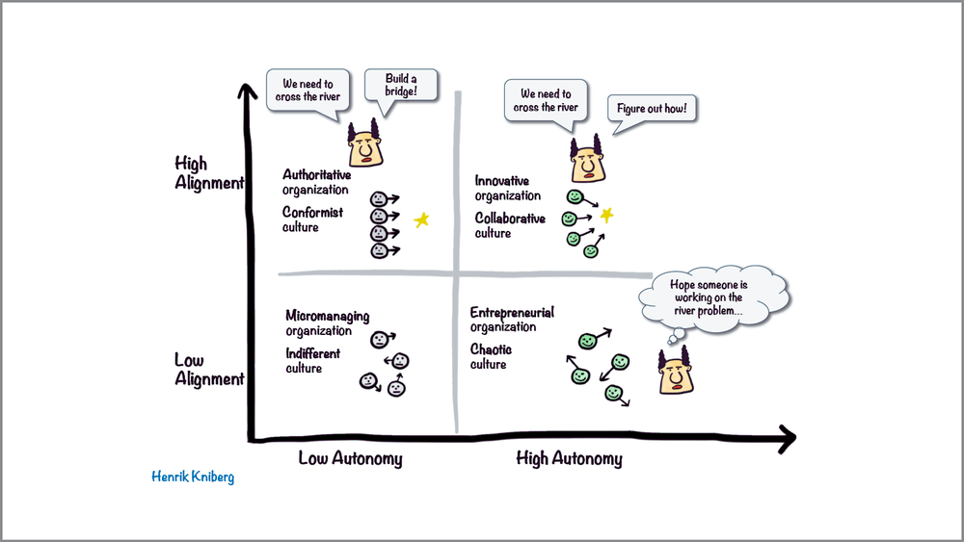
SIGNS OF AN
AUTONOMOUS WORKPLACE
ALIGNMENT ENABLES
AUTONOMY

Slide 19
Why autonomy is important
For individual
For team
Increased job satisfaction
Increased productivity
Personal growth
Adaptability and Resilience
Increased confidence
Improved collaboration
Increased productivity
Adaptability to change
Positive team dynamics
Better results

Slide 20



Keywords
BOUNDARIES AND CONSTRAINTS
OWNERSHIP
ACCOUNTABILITY

Slide 21
Smart Question
01
03
05
What makes a smart question
Why it’s important
Keywords
02
04
Steps
When to avoid asking

Slide 22
What makes a smart question
Open-endedness
Not a Yes/No question
Invite detailed and informative responses
Non-triviality
The answer not readily obvious or easily found
Requires the expertise of the person being asked
Clarity
Clearly articulated
Easy to understand
Critical thinking
Demonstrate critical thinking
Prompt the person being asked to delve deeper
Make the question genuinely worth answering
Comprehensiveness
Provide all the needed context
Specific, lean and simple

Slide 23




Steps of asking a smart question
Prepare related knowledge
1
2
Ask
6
3
Get feedback & show gratitude
Listen actively & take notes
5
4
Actively make use of the answer
Discuss/ask more if necessary

Slide 24
Why smart question is important
For individual
For team
Problem solving
Clarity
Learning and Growth
Innovation
Efficiency
Team engagement
Building trust
Effective communication

Slide 25


When to avoid asking questions
1
When the person is busy
2
Haven’t researched before
3
Inappropriate settings (someone else speaking, ...)
4
Related topic

Slide 26



Keywords
PREPARE BEFORE ASK
OPEN-ENDEDNESS
COMPREHENSIVENESS

Slide 27

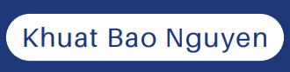
Thank you
I really appreciate your time.
Khuat Bao Nguyen

